Slide 1

Programming Fundamentals
Week # 1
Powerpoint Templates

Slide 2
Categories of Computers
Mainframe computers
Mainframes are high-performance computers with large amounts of memory and processors that process billions of simple calculations and transactions in real time.
Micro computers (personal computers)

Slide 3
Elements of a computer system
Basic Commands performed by computers
Input
Output
Storage
Arithmetic and logical operations
Components of a computer
Hardware
CPU
Main Memory (RAM)
Input /output devices
Secondary storage
Software

Slide 4
Elements of a computer system
Hardware: CPU and main memory
CPU
Brain
Most expensive piece
Powerful CPU → faster computer
Arithmetic/logical operations performed inside CPU

Slide 5
Central Processing Unit (CPU)
The main components of the CPU are:
Control unit (CU)
Arithmetic and logic unit (ALU).
Registers.

Slide 6
Central Processing Unit (CPU)
CU (Control Unit):
Fetches and decodes instructions
Controls flow of information in and out of MM
Controls operation of internal CPU components
ALU (arithmetic logic unit): carries out all arithmetic and logical operations

Slide 7
Central Processing Unit (CPU)
3. Registers.
PC (program counter): points to next instruction to be executed
IR (instruction register): holds instruction currently being executed

Slide 8
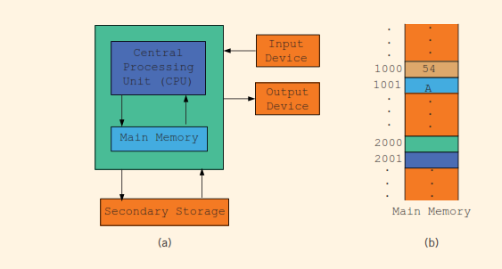
Elements of a computer system
Hardware: CPU and main memory

Slide 9
Elements of a computer system
Hardware: CPU and main memory
Main Memory (RAM)
Directly connected to CPU
All programs loaded in it before execution
All data brought in it before its manipulation
Volatile (everything lost when turned off)
Ordered sequence of memory cells
Each with unique location in memory (cell address)
Addresses help in accessing stored information

Slide 10
Elements of a computer system
Hardware: CPU and main memory
Main Memory (RAM)
Today, consists of millions to billions of cells
A cell can contain program instructions as well as data
Stores everything as sequence of 0s and 1s
Addresses are also expressed as sequence of 0s and 1s

Slide 11
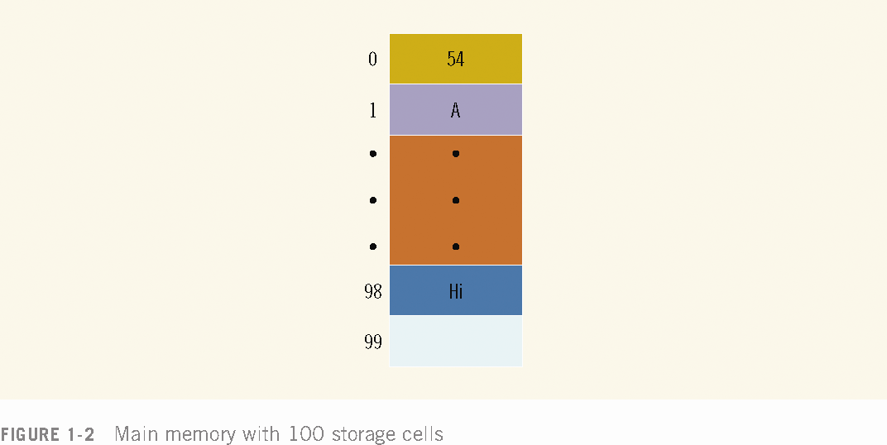

Slide 12
Elements of a computer system
Hardware: Secondary Storage
Program and data is loaded in main memory before processing
Main memory is volatile
Therefore
Information stored there needs to be transferred to other devices for permanent storage
Device responsible for such storage is Secondary storage ,i.e., hard disks, flash drives, CD-ROMs, etc
For such transfer of information both components directly connected with each other

Slide 13
Elements of a computer system
Hardware: Input / Output Devices
Input devices: Responsible for feeding data/programs into computers
Keyboard, mouse, secondary storage
Output devices: devices used for displaying results by computers
monitor, printer, secondary storage

Slide 14
Elements of a computer system
Software
Programs written to perform specific tasks
Written in programming languages
Types of programs
System Programs
Application Programs

Slide 15
Elements of a computer system
Types of programs
System: control computer like Operating system
loaded first when PC is turned on
Monitors overall activity
Provide services like memory management, storage management, input/output activities
Application: perform a specific task
Word processors, spread sheets, games
OS is responsible for running application programs

Slide 16
The Language of a Computer
Signals types:
Analog and Digital
Analog signals are continuous wave forms
used to represent such things as sound.
Audio tapes: stores data in analog signals.

Slide 17
The Language of a Computer
Signals types: Analog and Digital
Digital signals represent information with a sequence of 0s and 1s.
0 represents a low voltage
1 represents a high voltage
Digital signals are more reliable carriers of information than analog signals & can be copied from one device to another with exact precision.
Digital signals are processed inside a computer,
The language of a computer is called machine language,
Sequence of 0s and 1s (called a binary digit, or bit)
Sometimes a sequence of 0s and 1s is referred to as a binary code or a binary number

Slide 18
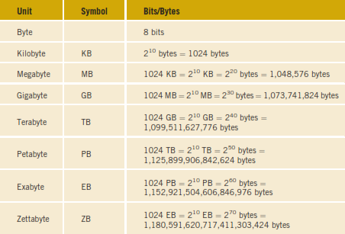
The Language of a Computer
Binary Units

Slide 19
The Language of a Computer
Computer uses a binary number system
As everything inside computer is shown as sequence of 1s and 0s
For 8 bit representation, add 0 on left for each ASCII 7-bit characters
EBCDIC consists of 256 characters
Unicode consist of 65536 characters (needs 2 bytes for each)
Notes:
EBCDIC, in full extended binary-coded decimal interchange code, data-encoding system, developed by IBM and used mostly on its computers, that uses a unique eight-bit binary code for each number and alphabetic character as well as punctuation marks and accented letters and nonalphabetic characters.
Unicode maps every character to a specific code, called code point. A code point takes the form of U+<hex-code>, ranging from U+0000 to U+10FFFF.
Unicode defines different characters encodings, the most used ones being UTF-8, UTF-16 and UTF-32.
UTF-8 is definitely the most popular encoding in the Unicode family, especially on the Web. This document is written in UTF-8, for example.

Slide 20
The Evolution of Programming Languages
Machine language: most basic language
Provides program instructions in bits
Most computers perform the same kinds of operations,
But the designers of the computer may have chosen different sets of binary codes to perform the operations
So, the machine language of one machine is not necessarily the same as the machine language of another machine
The only consistency among modern computers is that all data is stored and manipulated as binary codes

Slide 21
The Evolution of Programming Languages
Assembler: A program that translates an assembly language program into an equivalent machine language program
Compiler: A program that translates instructions written in a high-level language into the equivalent machine language
Interpreter: It translates high-level instructions into an intermediate form, which it then executes. Moreover, it converts the program by taking a single line at a time

Slide 22
C++ Program
#include <iostream>
using namespace std;
int main()
{
cout << "My first C++ program." << endl;
cout << "The sum of 2 and 3 = " << 5 << endl;
cout << "7 + 8 = " << 7 + 8 << endl;
return 0;
}
Sample Run:
My first C++ program.
The sum of 2 and 3 = 5
7 + 8 = 15

Slide 23
A C++ Program
cout << "My first C++ program." << endl;
This is a C++ output statement.
It causes the computer to
evaluate the expression after the pair
of symbols << and display the result
in the screen.
endl causes the insertion point
to move to the beginning of the
next line.
C++ contain various types of
Expressions such as arithmetic and
strings. For example: 7+8 is arithmetic
expression. Anything in double quotes
is a string “7+8” is a string

Slide 24
C++ Program
cout << "My first C++ program." << endl;
Sample Run:
My first C++ program.

Slide 25
A C++ Program
cout << "The sum of 2 and 3 = " << 5 << endl;
Sample Run:
The sum of 2 and 3 = 5
The first expression
“The sum of 2 and 3 = “ is
a string and evaluates to
itself .
The second expression consists of
Number 5 and evaluates to itself.

Slide 26
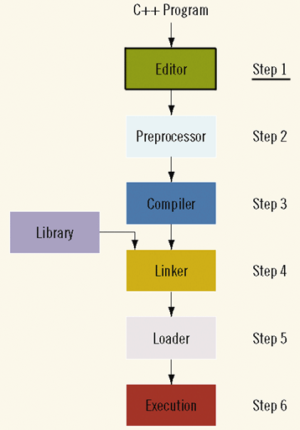
Processing a Program
The following steps are necessary to process a program in C++:
Step 1: Use text editor to create a C++ program. This program is called source code or source program.

Slide 27
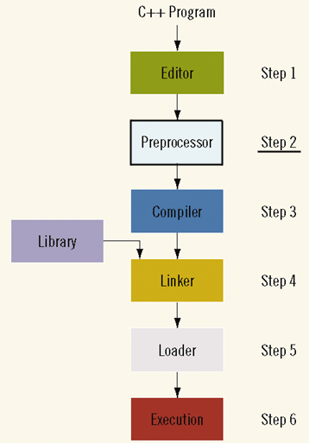
Processing a Program
Step 2: In a C++ program, statements that begin with the symbol # are called preprocessor directives.
These statements are processed by a program called preprocessor.

Slide 28
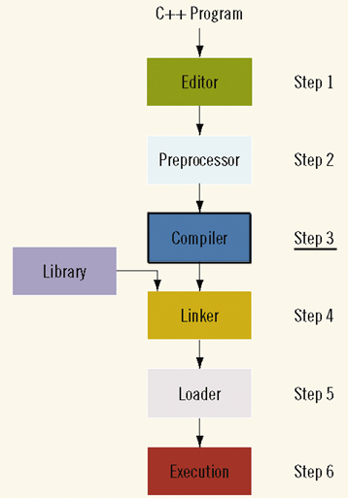
Processing a Program
Step 3: Compiler is used to:
verifies that the program obeys the rules of the programming language and checks the source program for syntax errors.
Translate the program into equivalent machine language (object program).

Slide 29
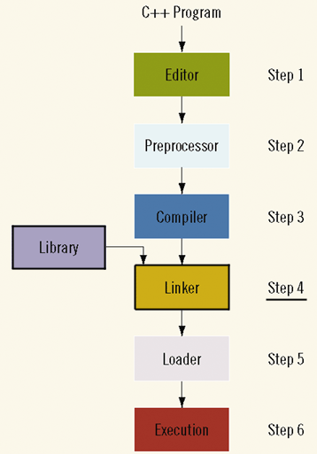
Processing a Program
Step 4: Programs in high level languages are developed using a software development kit (SDK).
SDK contains programs that are useful in creating your program such as mathematical functions.
The prewritten code resides in a library.
Linker combines the object code with the program from libraries.

Slide 30
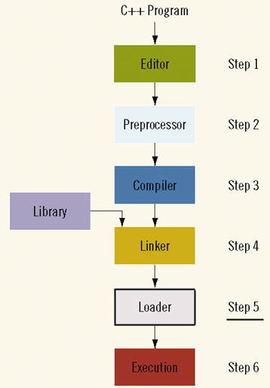
Processing a Program
Step 5: You must load the executable program into main memory for execution.
Loader: a program that loads an executable program into main memory.

Slide 31
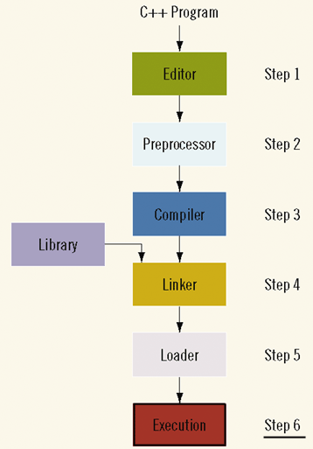
Processing a Program
Step 6: The final step is to execute the program.

Slide 32
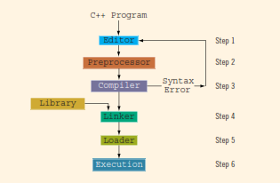
Processing a C++ Program
Steps required to process a C++ program
#include <iostream>
using namespace std;
int main()
{
Cout << “Hello to C++ World.” << endl;
return 0;
}

Slide 33
Processing a C++ Program
Steps required to process a C++ program
Step 1: Write a source program in text editor (with extension cpp)
Step 2: Add necessary preprocessor directives (begin with #)
Step 3: Write in correct syntax and translate in equivalent machine language i.e., object program (compiler)
Step 4: Combine object program with programs from libraries of IDE (linker)
Step 5: load program in main memory for execution (loader)
Step 6: Execute the program
Your concern is first step and master rules of the language for this (Dev C++ IDE)

Slide 34
Processing a C++ Program
Source program: A program written in a high level language
Preprocessor directives: statements that begin with the symbol #
Preprocesor: A program that processes pre-processor directives
Object program: The machine language version of the high-level language program
Linker: A program that combines object program with other programs in the library and used to create the executable code.
Loader: A program that loads an executable program into main memory.

Slide 35
Programming with the problem
Programming is a process of problem solving.
Algorithm is one common problem-solving technique
It is a step-by-step problem-solving process in which a solution is arrived at in a finite amount of time.
Problem-solving process requires the following three steps
1. Analyze the problem, outline the problem and its solution requirements, and design an algorithm to solve the problem.
2. Implement the algorithm in a programming language, and
verify that the algorithm works
3. Maintain the program by using and modifying it if the problem domain changes.

Slide 36
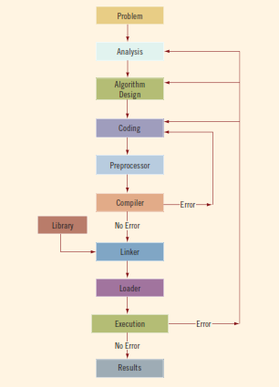
Programming with the problem
Problem analysis–coding–execution cycle

Slide 37
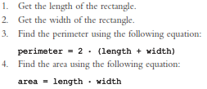
Programming with the problem
Algorithm examples
Perimeter and area of a rectangle

Slide 38
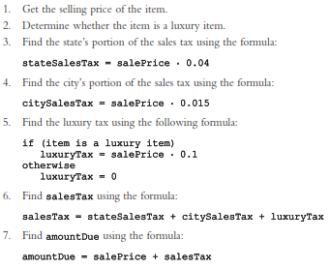
Programming with the problem
Algorithm examples
2. Calculate sales tax and price of item sold in a particular state
The state’s portion of the sales tax is 4%, and
the city’s portion of the sales tax is 1.5%.
If the item is a luxury item, such as a car more than $50,000, then there is a 10% luxury tax.

Slide 39
Programming with the problem
3. Calculates monthly paycheck of a salesperson at a local department store
Every salesperson has a base salary. The salesperson also receives a bonus at the end of each month, based on the following criteria:
If the salesperson has been with the store for five years or less,
the bonus is $10 for each year that he or she has worked there.
If the salesperson has been with the store for more than five years,
the bonus is $20 for each year that he or she has worked there.
The salesperson can earn an additional bonus as follows:
If the total sales made for the month are at least $5,000 but less than $10,000,
he/she receives a 3% commission on the sale.
If the total sales made for the month are at least $10,000,
he/she receives a 6% commission on the sale.

Slide 40
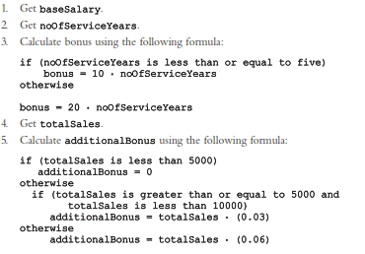

Programming with the problem
3. Calculates monthly paycheck of a salesperson at a local department store

